Slide 1
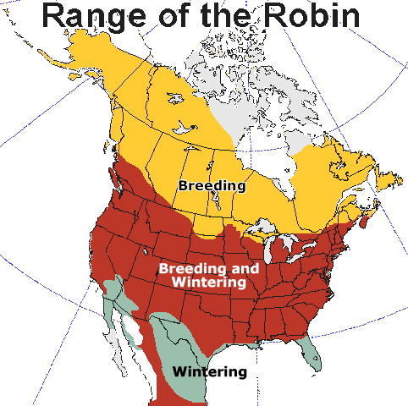
Cities are in the path of migration for many birds.
In what ways do you think cities can affect birds?

Slide 2
How do cities affect birds?
https://www.animalalliancenyc.org/wordpress/2022/01/urban-bird-city-dangers/

Slide 3
Add the following 6 main ways that cities affect birds and the info for each on the following slides.
Habitat loss and fragmentation
Predators
Reduced food availability
Increased noise levels
https://www.animalalliancenyc.org/wordpress/2022/01/urban-bird-city-dangers/
Competition
Light pollution

Slide 4
*This may look like a lot. You can paraphrase but do not leave out important ideas or keywords.
Habitat loss and fragmentation
Building cities & roads destroys and fragments habitats.
*When habitats get fragmented, it means that large areas are broken up into smaller isolated patches, which often lack the resources that birds need, such as nesting sites, food sources, and safe corridors for movement.
Increased noise levels
Constant noise pollution is a big source of stress for birds. It can interfere with their communication, making it difficult for them to attract mates, defend territories and warn each other of predators.
Artificial light at night disrupts the natural cycles that birds rely on for navigation, breeding and foraging for food.
Some migratory birds navigate using the stars and artificial lights can confuse them.
Light pollution
Info adapted from https://www.earth.com/news/urbanization-is-a-threat-to-78-of-the-worlds-bird-species/

Slide 5
*This may look like a lot. You can paraphrase but do not leave out important ideas or keywords.
Areas developed by humans often attract predators that birds wouldn’t encounter in natural areas.
Domestic cats are a major threat to ground-nesting birds and some birds may struggle to find food because of scavengers like rats or raccoons.
Predators
Reduced food availability
Human activities lead to population changes in different plant species. This can cause a decline in the types of plants and insects that birds rely on for food.
The use of pesticides and herbicides can directly harm bird populations or reduce the insect prey they depend on.
Competition
Because of the loss of habitat, birds face increased competition for limited resources, such as food and nest sites. Birds may be competing against other bird species whose habitat has been reduced as well as invasive species that humans may have introduced.

