Slide 1
Let’s take a moment to look at this image together…
We’ll begin with 2 minutes of SILENT observation.

Slide 3
Now, let’s discuss some ground rules:
All ideas are welcome. Be respectful. Raise your hand before you speak. Build on each other’s ideas, but it’s okay to disagree with kindness.

Slide 4
Things to keep in mind…
Step outside your comfort zone. There are no “right” or “wrong” answers.
If you’re the kind of person who always speaks first, please try to step back. If you’re the kind of person who always waits for others to speak, try to step up.

Slide 5
Notes:
Now that we have all looked together, I know there are still more ideas. Turn to a person sitting next to you and share more or share something you didn't share with the larger group.

Slide 6
Now let’s take a look at a few images with and without data
Think about the following:
What’s going on in this image?
What do you see that makes you say that?
What more can we find?

Slide 7
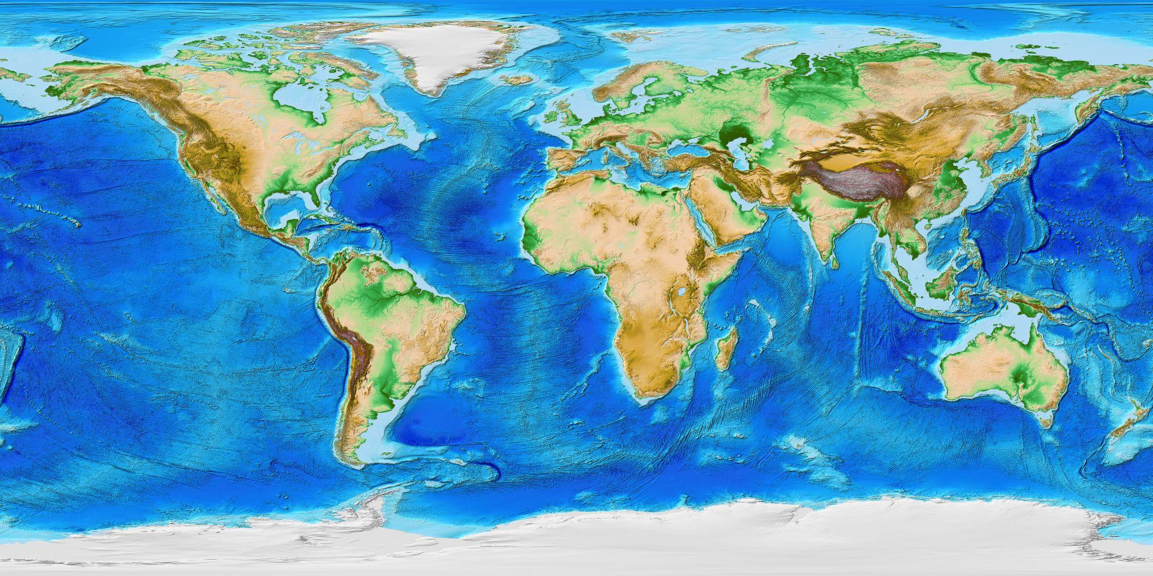

Slide 9
