Slide 1
Let’s start out by taking a look at some artwork.
2 minutes of SILENT observation. Then, let’s discuss.
Ground rules:
All ideas are welcome.
Be respectful.
Raise your hand before you speak.
Build on each other’s ideas, but it’s okay to disagree with kindness.
Notes:
Ground rules even more important here as I work with my academic (non-honors) students

Slide 2
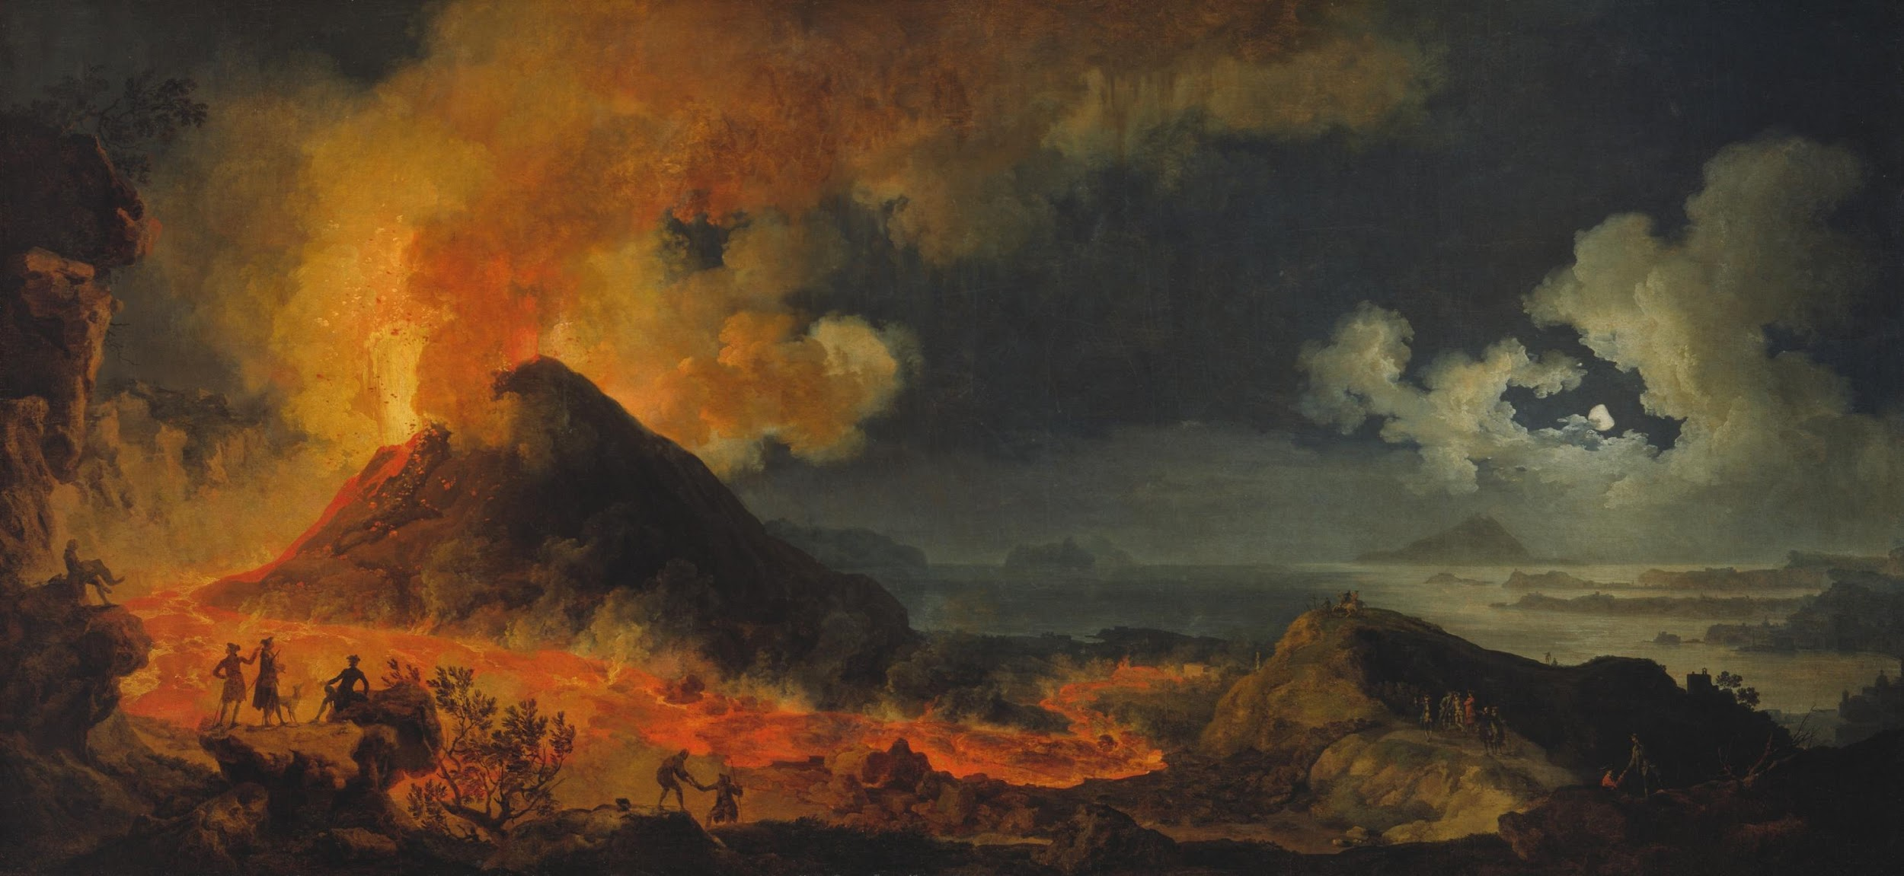
Notes:
Dave Curry’s Art choice for VTS Unit: Earth’s Systems (plate tectonics unit)
Pierre-Jacques Volaire, French, 1729–c. 1790-1800. The Eruption of Vesuvius, 1771. Oil paint on canvas. Purchased by the Art Institute of Chicago in 1978.

Slide 4
Now let’s take a look at a few images with and without data
Think about the following:
What’s going on in this image?
What do you see that makes you say that?
What more can we find?

Slide 5
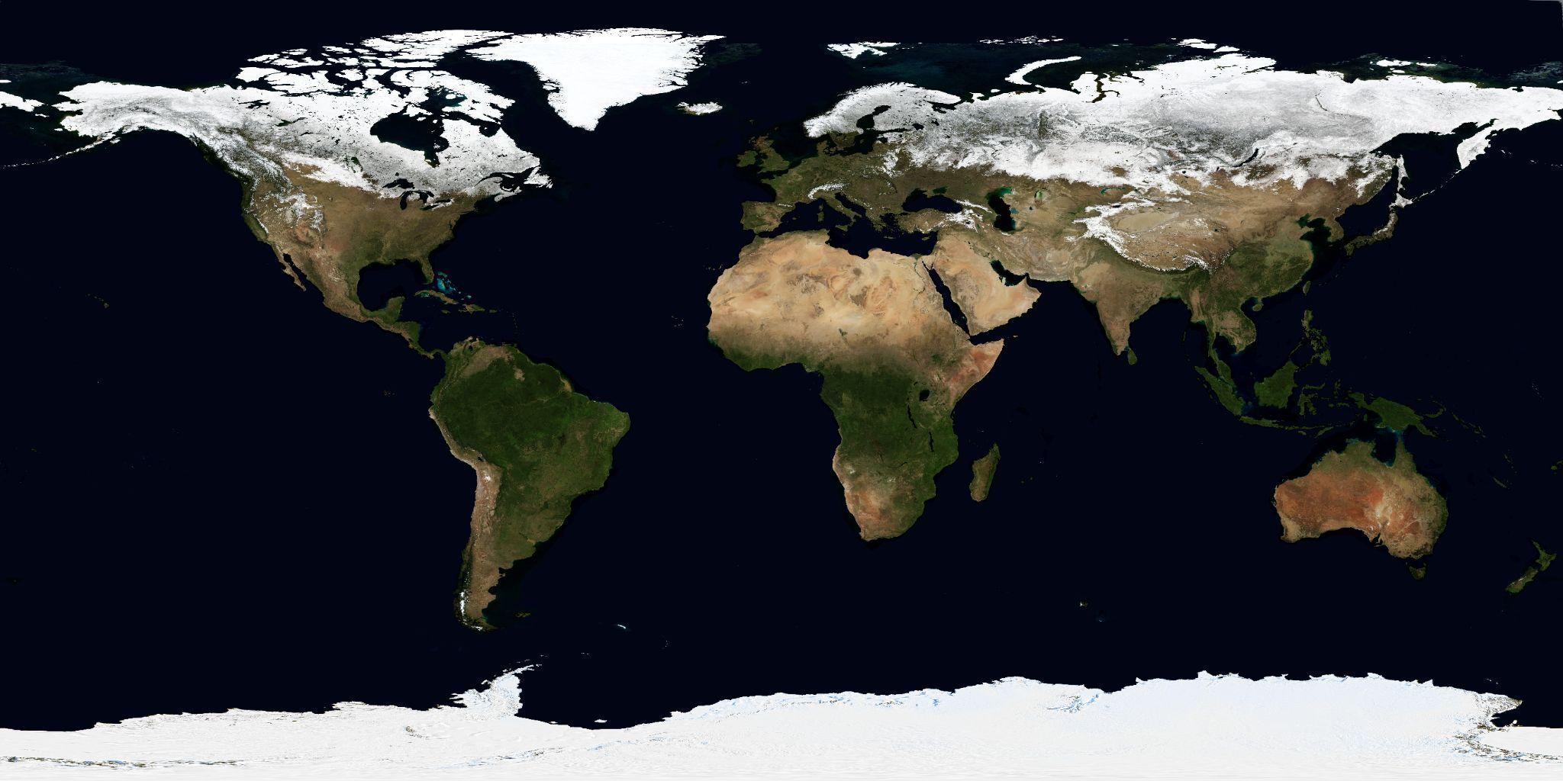
Notes:
This image shows far less data, leaving ocean depth purely to the student imagination
Source: https://visibleearth.nasa.gov/images/73992/march-blue-marble-next-generation/74003l

Slide 6
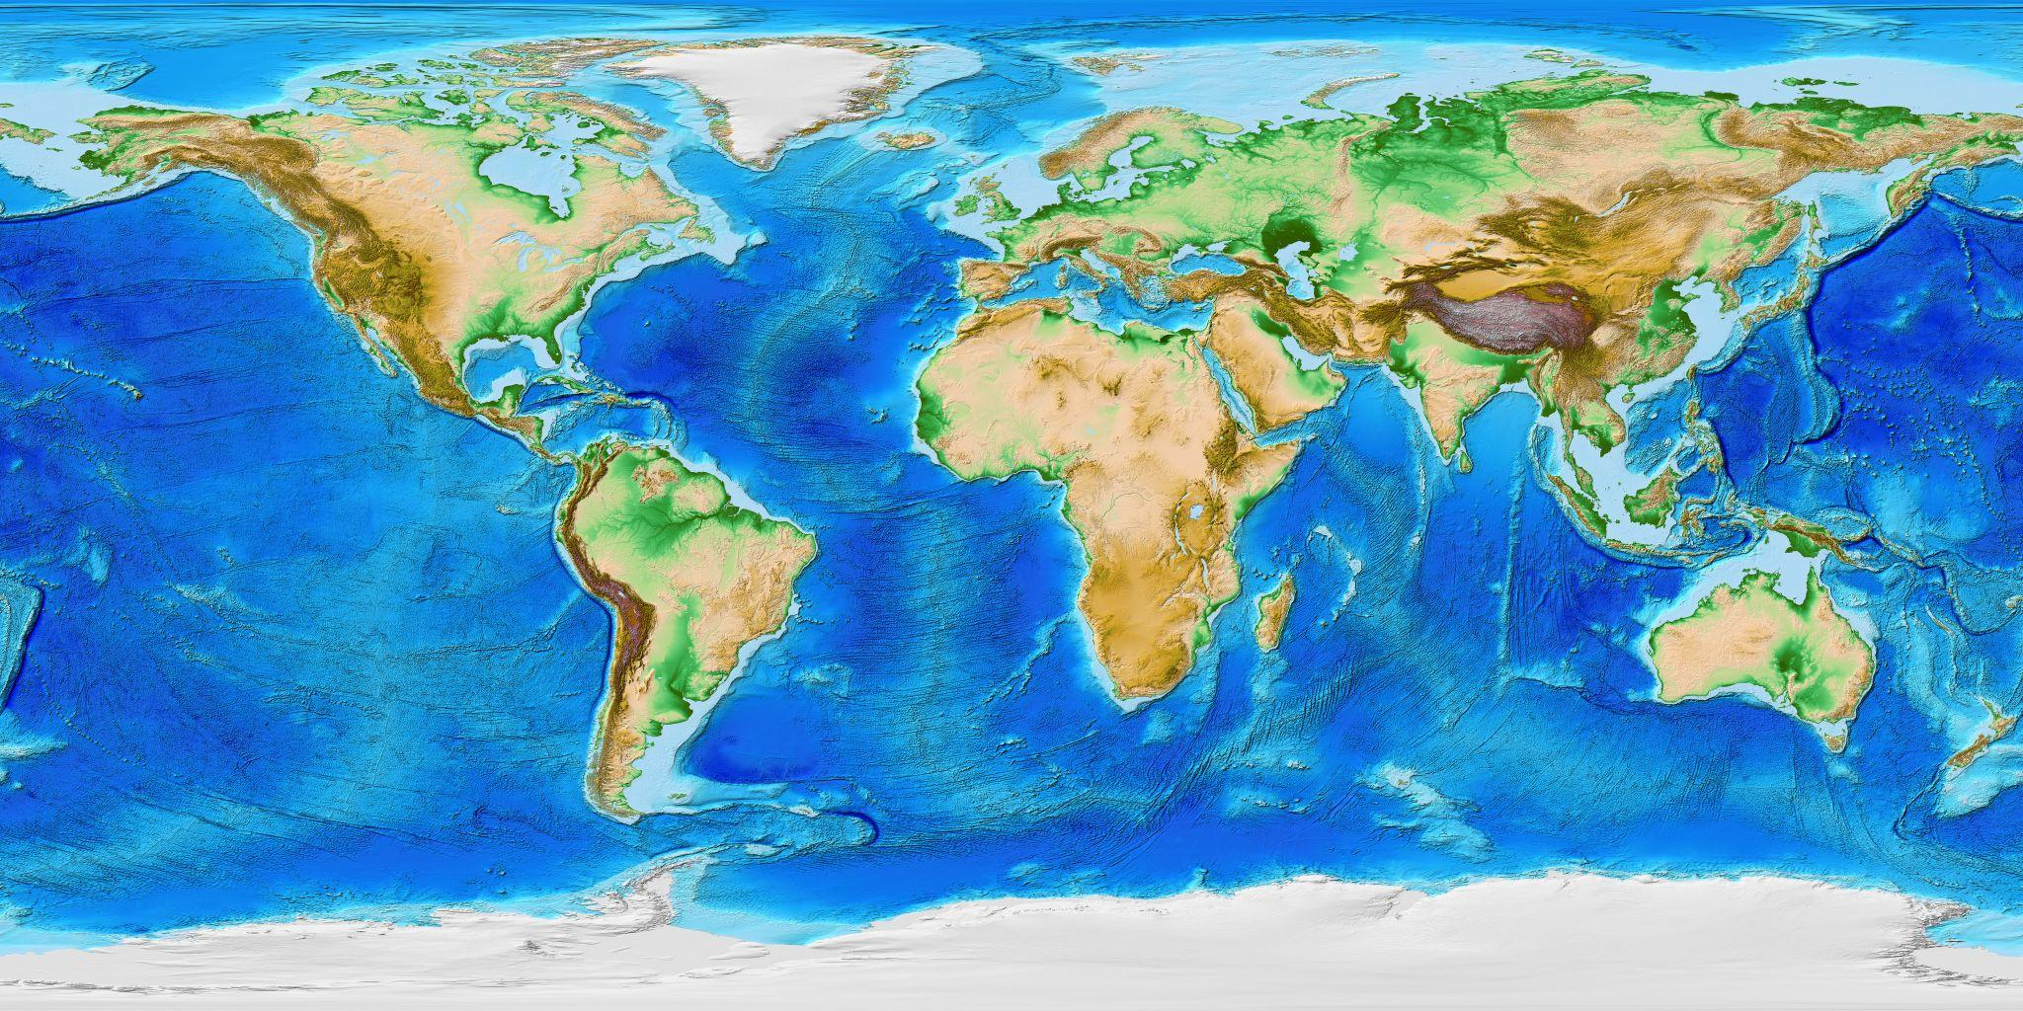
Notes:
Base layer, no additional data

Slide 7
Notes:
SOS image: Volcanic eruptions, up to 2010
source:

Slide 8
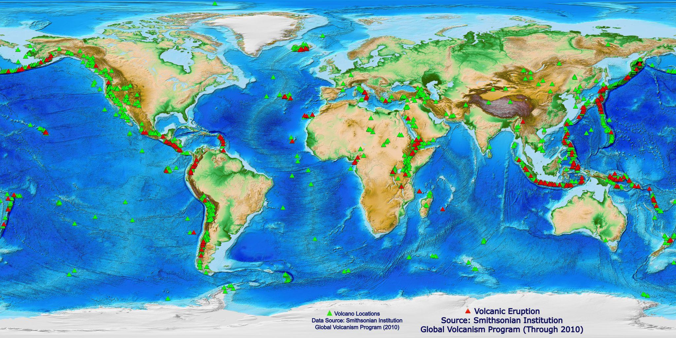

Slide 10
Now let’s take a look at a few images with and without data
Think about the following:
What’s going on in this image?
What do you see that makes you say that?
What more can we find?

Slide 11
Notes:
Source: https://visibleearth.nasa.gov/images/73992/march-blue-marble-next-generation/74003l

Slide 12
Notes:
Base layer, no additional data Can we find a legend, Add Green and Red triangles

Slide 13
Notes:
Volcano locations, all known volcanoes up to 2010
Source: https://sos.noaa.gov/catalog/datasets/volcano-locations/

Slide 15
Notes:
put red and

Slide 16
Now let’s take a look
at a related animation
Think about the following:
What’s going on in this image?
What do you see that makes you say that?
What more can we find?

Slide 17
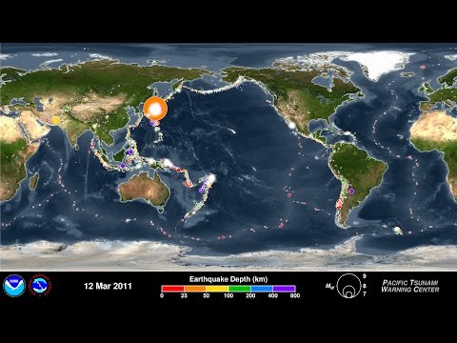
Notes:
Same data as: SOS - https://sos.noaa.gov/catalog/datasets/earthquakes-2001-2015/

Slide 19
Now let’s take a look at a few images with and without data
Think about the following:
What’s going on in this image?
What do you see that makes you say that?
What more can we find?

Slide 20
Notes:
Source: https://visibleearth.nasa.gov/images/73992/march-blue-marble-next-generation/74003l

Slide 21
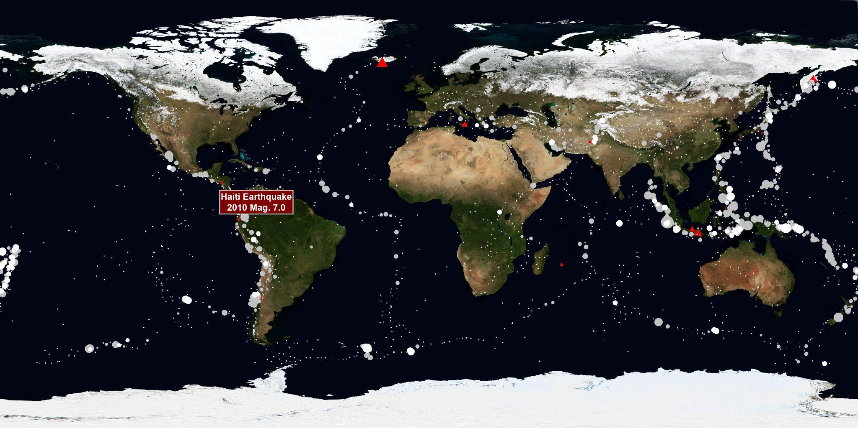
Notes:
Earthquakes and Volcanoes: 50 years Source: https://sos.noaa.gov/catalog/datasets/earthquakes-and-eruptions-1960-2010/

Slide 22
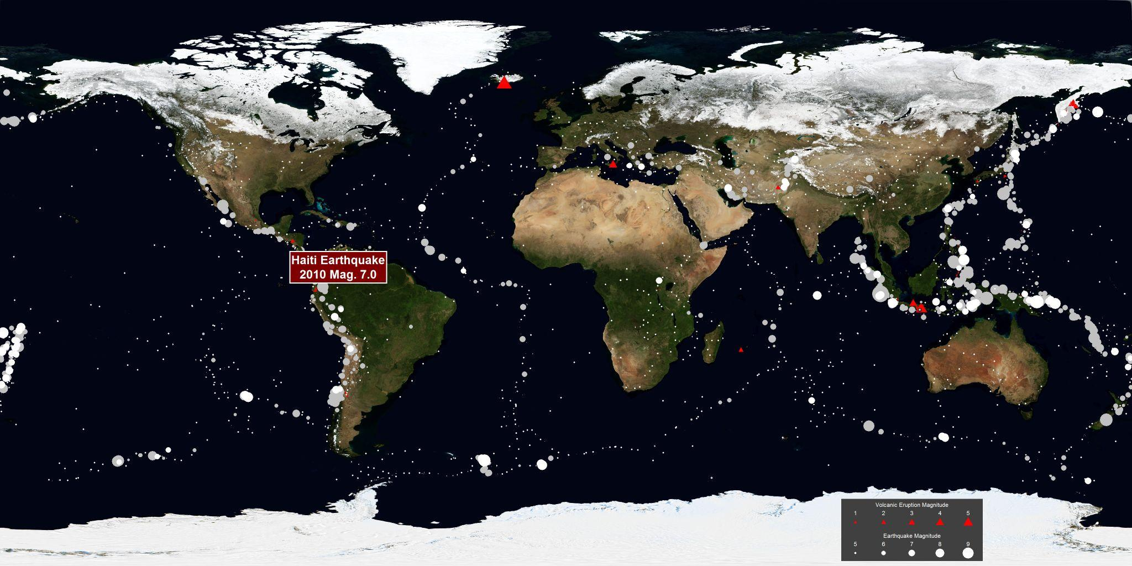
Notes:
Earthquakes and Volcanoes: 50 years, Source: https://sos.noaa.gov/catalog/datasets/earthquakes-and-eruptions-1960-2010/
With Legend

Slide 23
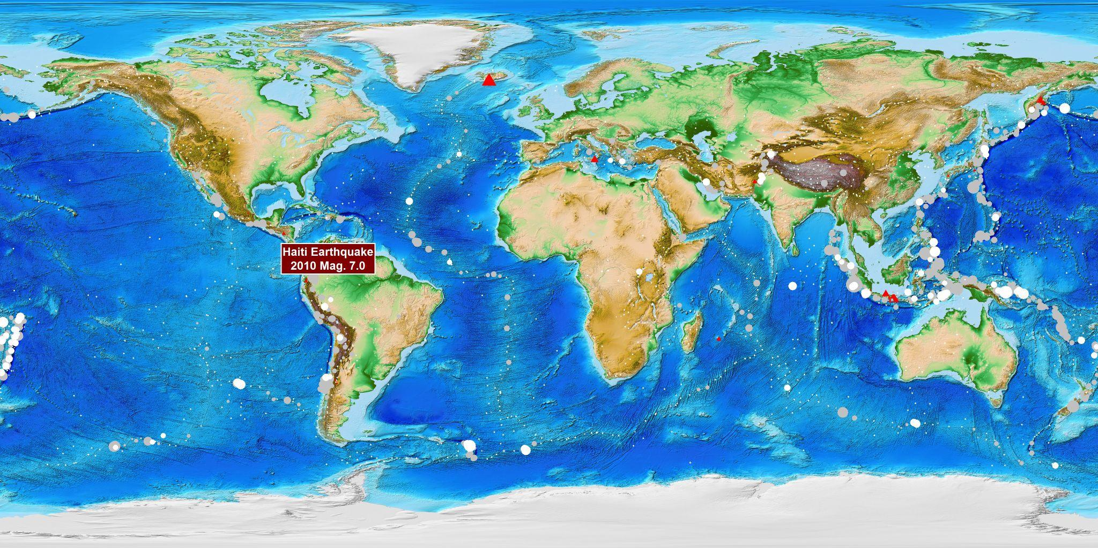
Notes:
Adding the bathymetric and topographic values (same data source)

Slide 24
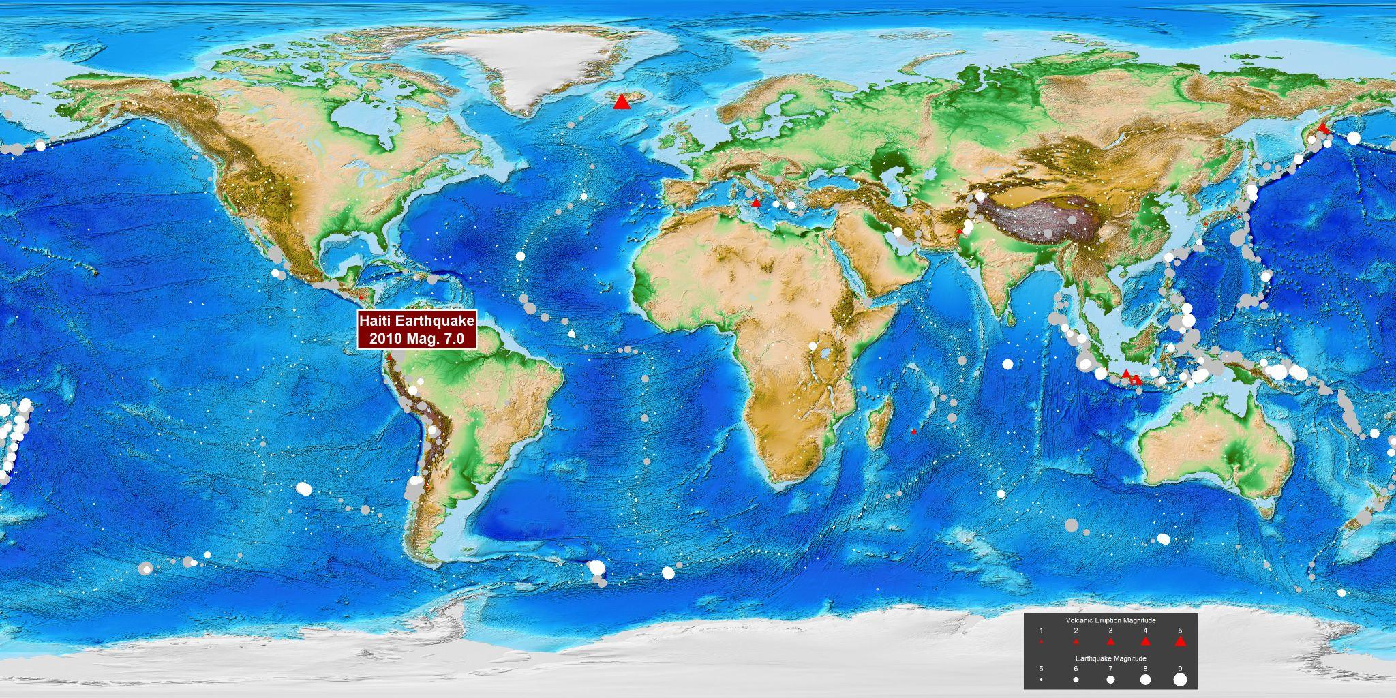
Notes:
Now finally the legend

