Slide 1
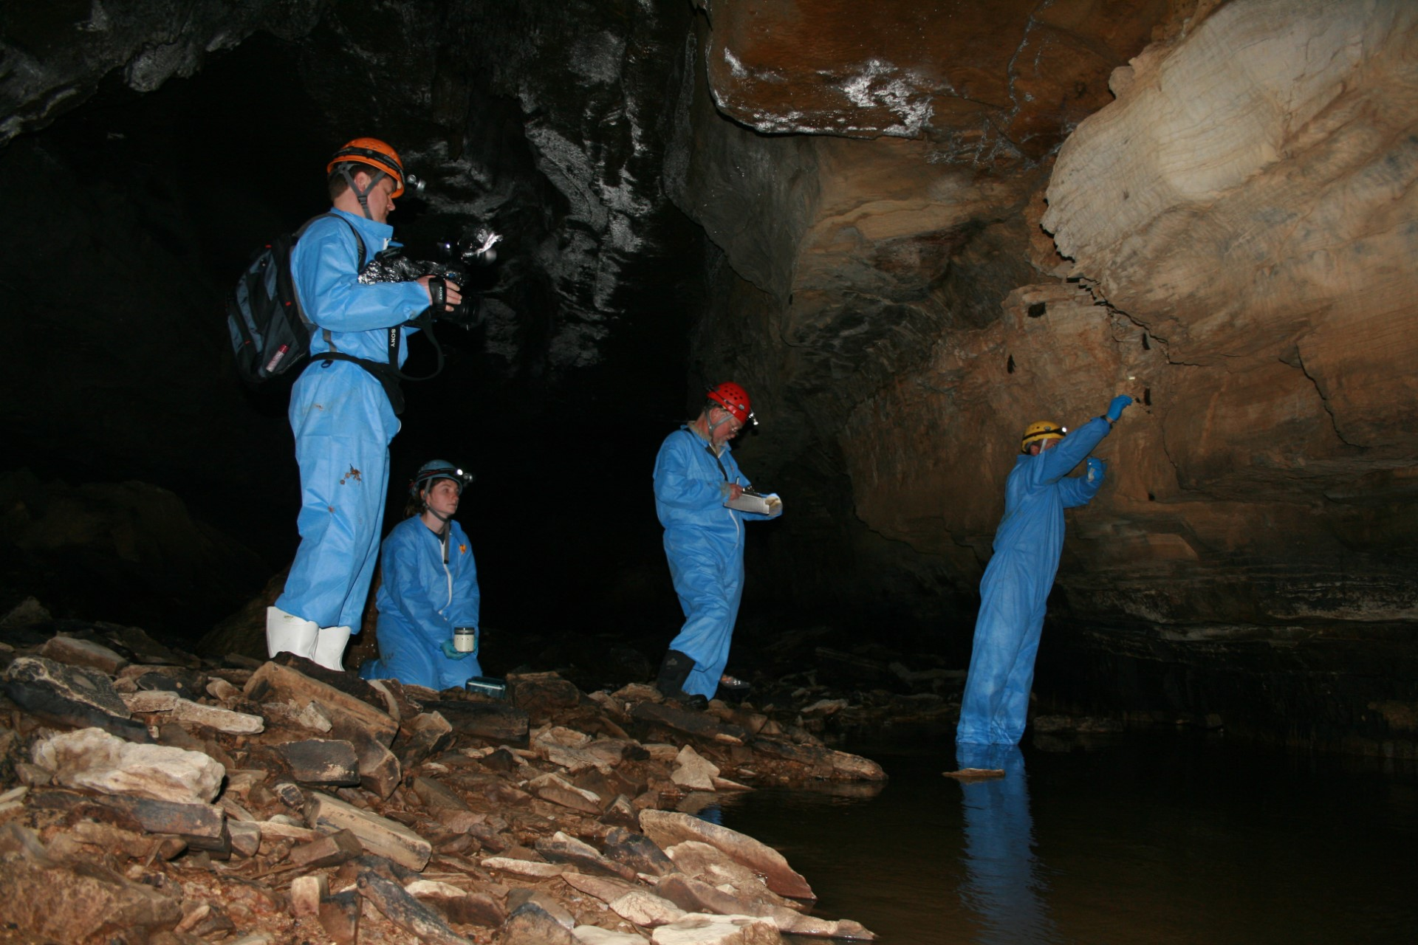

Slide 2
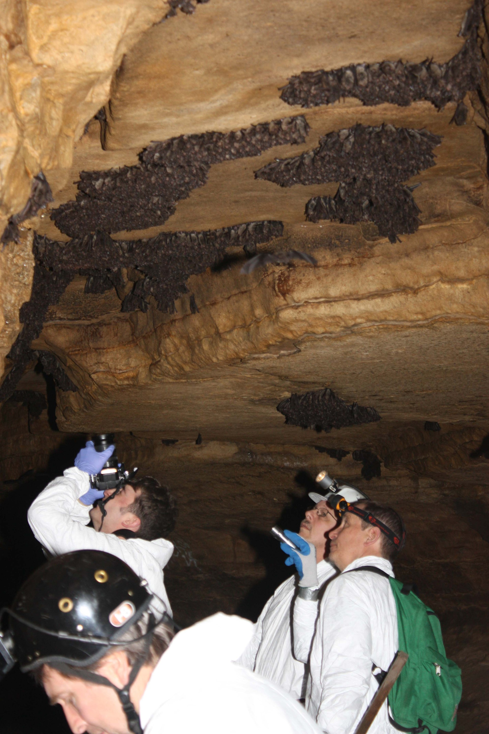

Slide 3
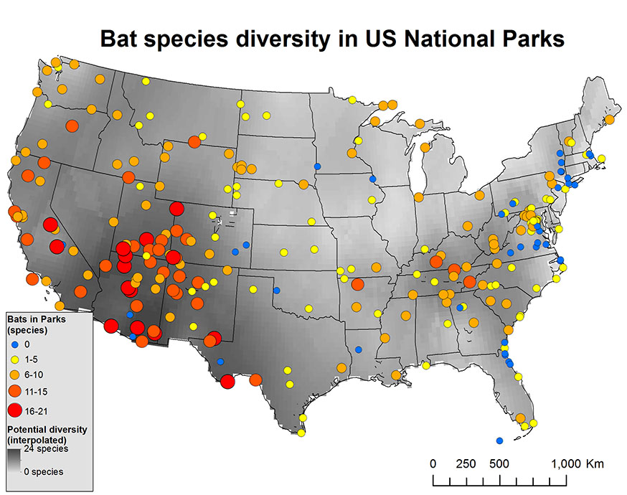
Notes:
https://www.nps.gov/orgs/1778/images/batdiversity_nov16.jpg

