Slide 1
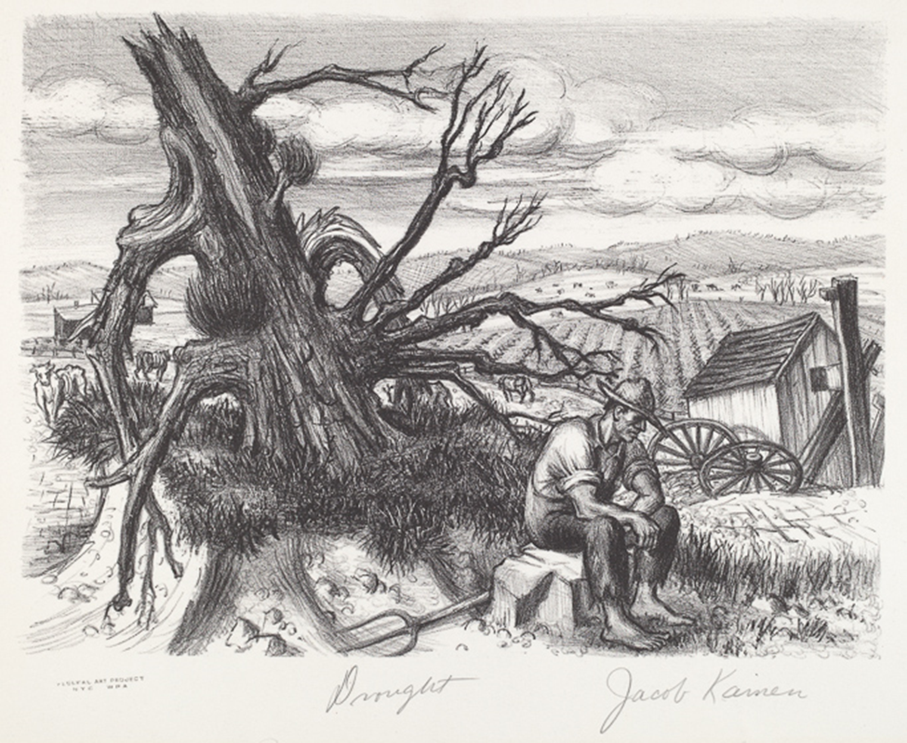
Notes:
Jacob Kainen, Federal Art Project (New York City), Drought, 1935, lithograph, Reba and Dave Williams Collection, Gift of Reba and Dave Williams, 2008.115.2754
In Jacob Kainen’s work, what signs do you see in the picture that offer clues to the state of the environment? You may notice the farmer’s downcast appearance as well as the twisted, dead tree, sandy-looking soil, bony livestock, and sparse vegetation in the fields. Discarded wagon wheels may indicate there is nothing to harvest or transport

Slide 2
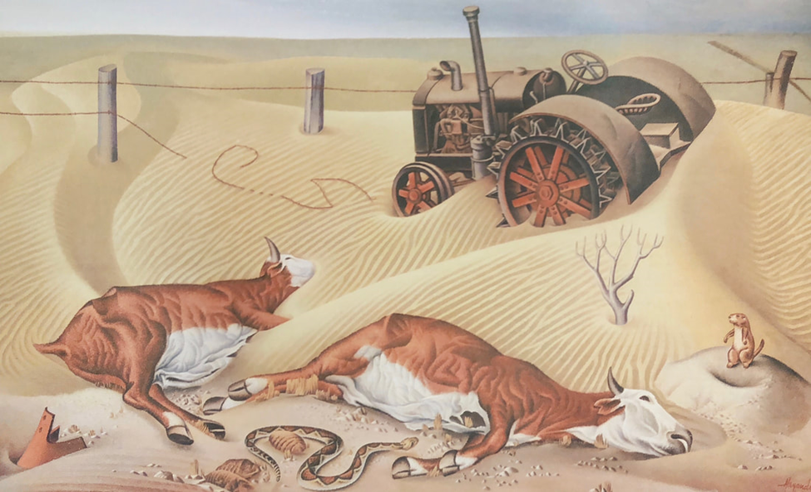
Notes:
Alexandre Hogue, Drouth Survivors, 1936, Oil on canvas, Musée de la cooperation franco-américan, Blérancourt, France.

Slide 3
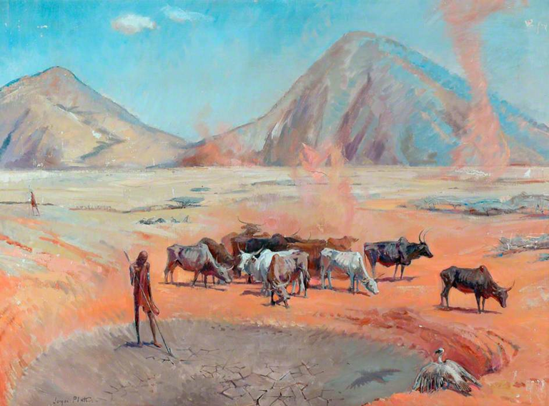

Slide 4
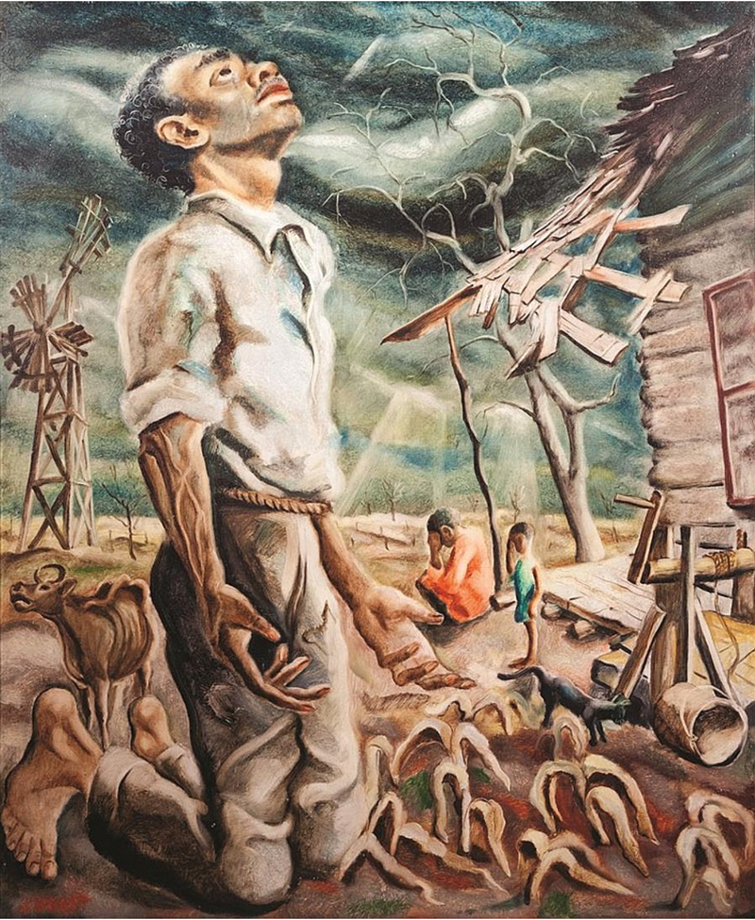
Notes:
Joseph Paul Vorst, American (1897-1947), Drought, oil on masonite, 30 x 25 inches

Slide 5
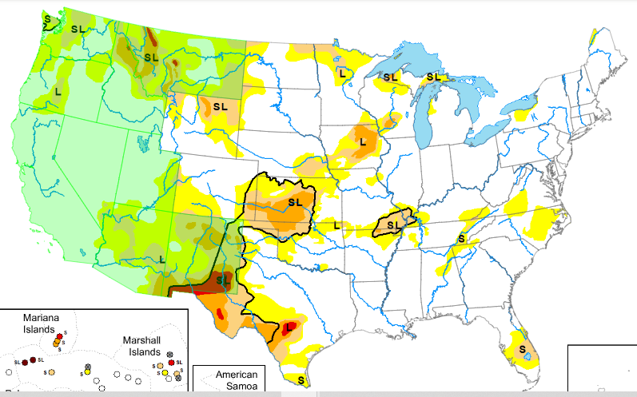
Notes:
https://droughtmonitor.unl.edu/CurrentMap.aspx

Slide 6
Notes:
https://droughtmonitor.unl.edu/CurrentMap.aspx
In central Texas, a tight gradient in long-term drought conditions has developed, as heavier rains have recently fallen along the northern edge of moderate to extreme long-term drought conditions. Some reservoirs have seen some recent improvement in levels in the area, though significant deficits remain. In deep south Texas, dry weather over the last month or two has led to significant short-term precipitation deficits, and a small area of short-term moderate drought developed.

