Slide 1
Observation & Discussion
Observe images silently
Quiet write in notebooks
Group share: “What’s going on in this image?”
1
2

Slide 2
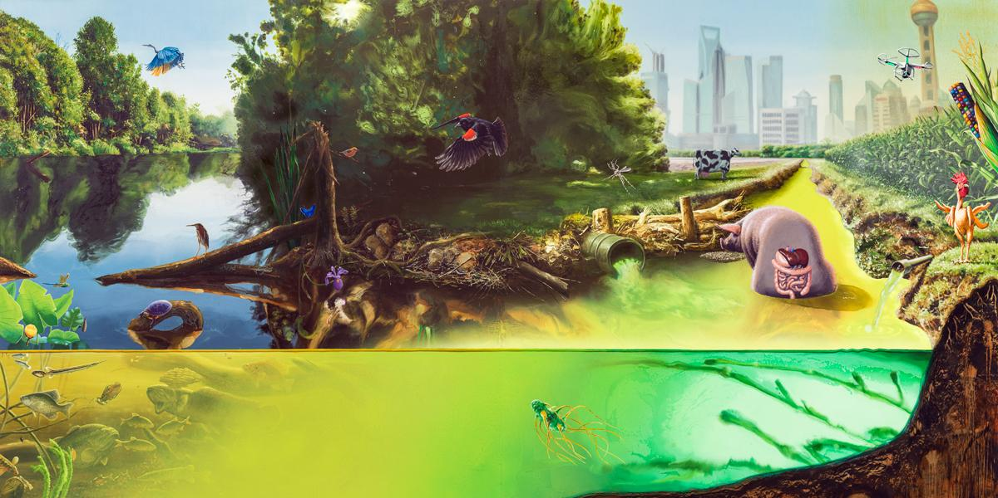
What’s going on in this image?

Slide 3
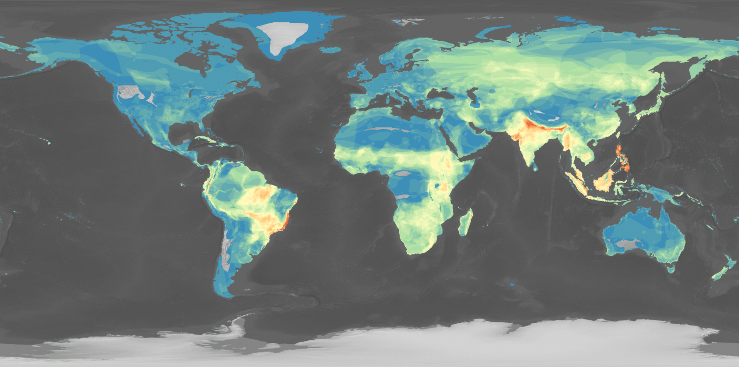
What’s going on in this image?

Slide 4
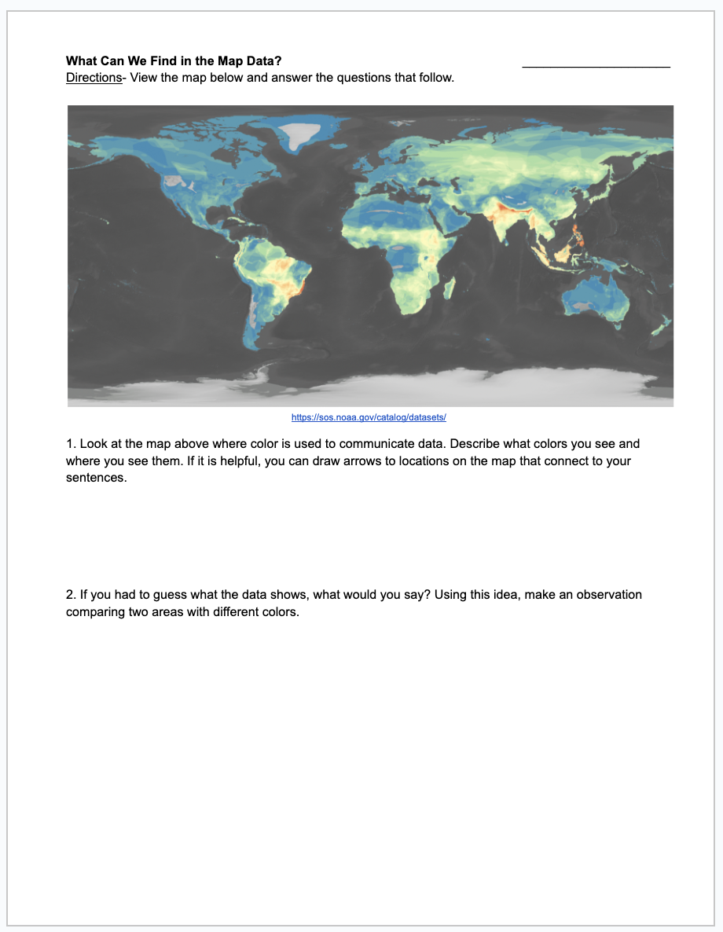
Before seeing the title of this map, students will take a few minutes to write about what they think they are seeing in this map.
Link to handout

Slide 5
What’s going on in this image?

Slide 6
What questions do we have about the map image?

Slide 7
Watershed, Alexis Rockman (2015). Collection Jonathan O'Hara © 2015 Alexis Rockman

